Slide 1
Positive Integers
4 bytes (32 bits) per integer, first bit for sign, remaining 31 bits for value
Example: Store integer 65 in memory
65 in binary = 00000000 00000000 00000000 01000001
MSB (most significant bit) = 0, since the number is positive
This binary equivalent of 65 will be stored in 32-bit memory:
00000000 00000000 00000000 01000001
Byte 4
Byte 3
Byte 2
Byte 1
00000000
00000000
00000000
01000001

Slide 2
Negative Integers
4 bytes (32 bits) per integer, first bit for sign, remaining 31 bits for value
Example: Store integer -65 in memory
Negative numbers = Use 2’s complement
65 in 32-bit binary = 00000000 00000000 00000000 01000001
2’s complement = 11111111 11111111 11111111 10111111
MSB (most significant bit) = 1, since the number is negative
Byte 4
Byte 3
Byte 2
Byte 1
11111111
11111111
11111111
10111111

Slide 3
Summary
Positive and negative numbers: +65 and -65
Byte 4
Byte 3
Byte 2
Byte 1
00000000
00000000
00000000
01000001
+65
11111111
11111111
11111111
10111111
-65

Slide 4
Floating Point Numbers Storage in Memory
Consider 4.25₁₀
Integer part: Convert 4₁₀ into binary … 4₁₀ = 100₂
Fractional part = 0.25₁₀
Multiply fractional part with 2 until it becomes 1.0
0.25 * 2 =0.50 take 0 and move 0.50 to next step
0.50 * 2 =1.00 take 1 and stop the process as there is no remainder
0.25 = 01₂
4.25 = 100.01₂

Slide 5
Exercise
Convert decimal 10.75 into binary
Integer part
10₁₀ = 1010₂
Fractional Part
0.75 * 2 =>1.50 // take 1 and move .50 to next step
0.50 * 2 =>1.00 // take 1 and stop the process because there is no remainder
0.75₁₀ = 11₂
Combining the two parts:
10.75₁₀ = 1010.11₂

Slide 6
Exercise
Convert decimal 2.33 into binary

Slide 7
Solution
Integer part: 2₁₀ = 10₂
Fractional part:
0.33 * 2 =>0.66 // take 0 and move .66 to next step
0.66 * 2 =>1.32 // take 1 and move .32 to next step
0.32 * 2 =>0.64 // take 0 and move .64 to next step
0.64 * 2 =>1.28 // take 1 and move .28 to next step
0.28 * 2 =>0.56 // take 0 and move .56 to next step
0.56 * 2 =>1.12 // take 1 and move .12 to next step
0.12 * 2 =>0.24 // take 0 and move .24 to next step
0.24 * 2 =>0.48 // take 0 and move .48 to next step
0.48 * 2 =>0.96 // take 0 and move .96 to next step
0.96 * 2 =>1.92 // take 1 and move .92 to next step
0.92 * 2 =>1.84 // take 1 and move .84 to next step
0.84 * 2 =>1.68 // take 1 and move .68 to next step
0.68 * 2 =>1.36 // take 0 and move .36 to next step
0.36 * 2 =>0.72 // take 0 and move .72 to next step
0.72 * 2 =>1.44 // take 1 and move .44 to next step
0.44 * 2 =>0.88 // take 0 and move .88 to next step
0.88 * 2 =>1.76 // take 1 and move .76 to next step
0.76 * 2 =>1.32 // take 1 and move .32 to next step

Slide 8
Solution
Here, the fractional part 0.32 which is repeating again
We will not get 1.0 using this method
In floating number storage, the computer will allocate 23 bits for the fractional part. So, it is enough to stop the above method after 23 fractional digits
2.33₁₀ = 10.010101000111001011₂

Slide 9
Storing Floating Point Numbers in Computer Memory
A floating point number is stored in memory as made up of three parts:
Sign
Exponent
Significant value

Slide 10
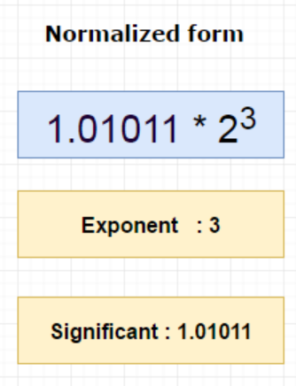
Storing Floating Point Numbers in Memory – Step 1: Significant Part
We need to convert the number into the normalized form
For floating point numbers, we need to normalize it as:
1.significant bit * 2 ^{exponent}
Decimal 10.75 = Binary 1010.11
So, 1010.11 will be normalized as: 1.01011 * 2³
Because, after the first 1, we write the decimal
point and then write the remaining digits
of the original number (i.e. 01011)
Significant part is 1.01011 in binary

Slide 11
Storing Floating Point Numbers in Memory – Step 2: Calculate Exponent
We do not use 2’s complement for floating point numbers
We need to add bias to the exponent, regardless of whether the number is positive or negative
bias_{n} = 2^{n-1} – 1 … Note n = Number of bits used for exponent
bias₈ = 2⁸ ⁻ ¹ -1 = 127
Hence the normalized exponent value will be:
Actual exponent = Exponent + bias value which is 3 + 127 = 130
So, the final exponent is 130
Binary form of 130 is 10000010₂

Slide 12
Storing Floating Point Numbers in Memory – Summary
Sign bit = 0, because 10.75 is positive
Exponent = 130, which is 10000010
Significant value is 1.01011, here we eliminate 1 before the dot (.) and just take the part after the dot, i.e. only 01011

Slide 13
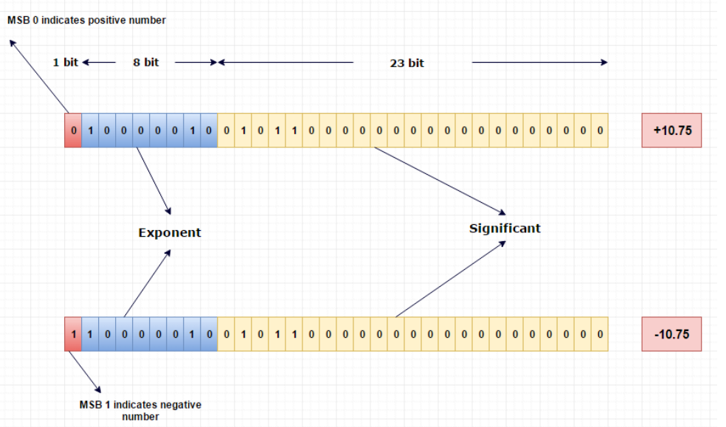
Storing Floating Point Numbers in Memory – End Result

Slide 14
Demo: Binary Addition
In the emu8086 program, type this code:
org 100h
mov ax, 3333
mov bx, 1111
add ax, bx
ret
First set two integer values in two registers
Then add the value in the first register to the value of the second register

Slide 15



Demo: Reading From Memory
In the emu8086 program, type this code:
org 100h
mov ax, [0x00]
ret
Run a single step
Before the move instruction is executed, note down the contents of memory location 00 and that of ax
Now execute the move instruction and recheck ax
Retry by changing to: mov ah, [0x00] and mov al, [0x00]

Slide 16
Using Variables – Simple
ORG 100H
MOV AL,VAR1
MOV BX,VAR2
RET ; STOPS THE PROGRAM
VAR1 DB 7
VAR2 DW 1234H
View the memory to see where these variables are created by the CPU

